Slide 1
Day One Review
HILT 2019

Slide 2
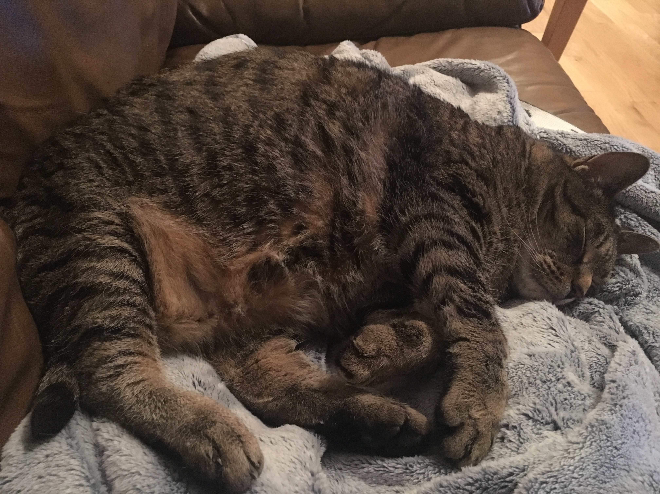
Day One Review – HILT 2019
Notes:
short-hair / long-hair
i'm sleepy

Slide 3
Command Line
How do you know where you are?
How do you make a new folder?
How do you move in to a directory?
How do you see all the files in a directory?
How do you look up what a command does?

Slide 4
Git
How do you create a git repository?
What is the git workflow we kept going over?
What is GitHub?
What is the relationship between git and GitHub?
How do you know if your code got to github?

Slide 5
Python
What are some of the data types?
What is a variable?
What is a method?
Why Python? Why not?

Slide 6
Python
What is an operator?
What is the Python interpreter? Is it awesome?
How do you assign a variable?
What is Duck Typing?
How do you run a command-line program?

Slide 7
Some Math
75 + 60 + 60 + 105 = 300
90 + 75 + 75 + 120 = 360
90 + 75 + 60 + 105 = 330
90 + 75 + 60 + 105 = 330
1320 / 90 = 7.3 repeating

Slide 8
Some Math
75 + 60 + 60 + 105 = 300
90 + 75 + 75 + 120 = 360
90 + 75 + 60 + 105 = 330
90 + 75 + 60 + 105 = 330
1320 / 90 = 7.3 repeating
Roughly seven weeks worth of class in four days.

Slide 9
Questions
What are three things you want clarified or discussed further right now?
Don't say everything.
Any other questions that have come up?

Slide 10
Troubleshooting
Don't flail – find information and be deliberate.
Where are you? - pwd
What do you see there? - ls
Where are you in the git workflow? git status
Do these commands confirm what you expected?
$ cd vs $ cd ..

Slide 11
Review - in Pairs
Working with the local copy of your github repository, make a Python file that executes some code based on some of the concepts from yesterday – printing; assigning variables; etc.
Run it to make sure it works.
Link to it from the index.html page in your portfolio.
Use the standard git workflow to push it to github.

